Slide 1
Azure Event Hub
[Speaker Name]

Slide 2
Azure Event Hubs is a hyper-scale telemetry ingestion service which collects, transforms and stores millions of events. As a distributed streaming platform, it gives you low latency and configurable time retention, which enables you to ingress massive amounts of telemetry into the cloud and read the data from multiple applications using publish-subscribe semantics

Slide 3
Azure Event Hub
Log millions of events per second in near real-time
Send telemetry data automatically to storage
Use time-based event buffering
Get a managed service with elastic scale
Reach a broad set of platforms using native client libraries
Seamlessly integrate with other Azure services

Slide 4
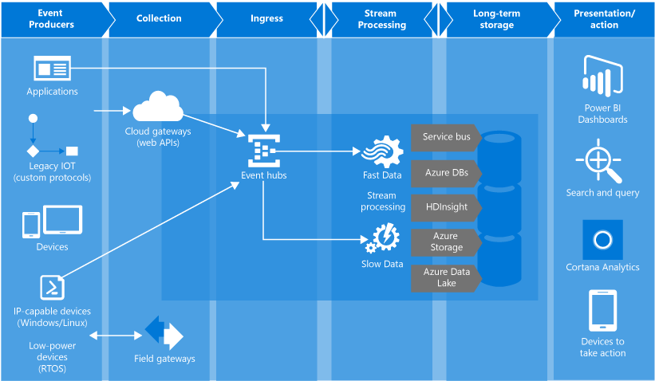
Architecture

Slide 5
Event Hubs features
Event producers/publishers:
An entity that sends data to an event hub. An event is published via AMQP 1.0 or HTTPS
Capture:
Enables you to capture Event Hubs streaming data and store it in an Azure Blob storage account
Partitions:
Enables each consumer to only read a specific subset, or partition, of the event stream
SAS tokens:
Identifies and authenticates the event publisher
Event consumers:
An entity that reads event data from an event hub. Event consumers connect via AMQP 1.0
Consumer groups:
Provides each multiple consuming application with a separate view of the event stream, enabling those consumers to act independently
Throughput units:
Pre-purchased units of capacity. A single partition has a maximum scale of 1 throughput unit

Slide 6
Demo

